Slide 1
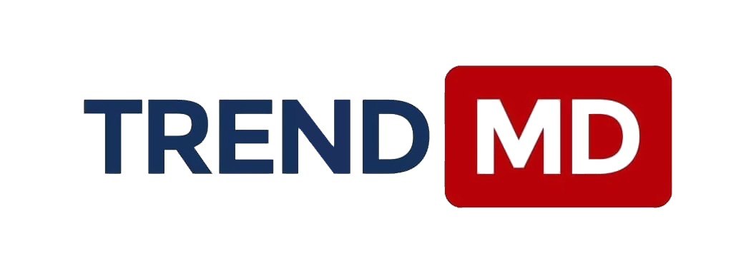
TrendMD Endeavors to Develop OA Publishing
Tash Brown
TrendMD, COO

Slide 2
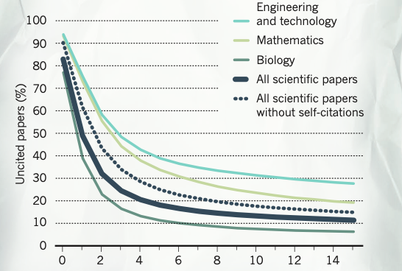
Uncited research papers from 1900-2015 — 21%
https://media.nature.com/original/magazine-assets/d41586-017-08404-0/d41586-017-08404-0.pdf
Notes:
For the literature as a whole — 39 million research papers across all disciplines recorded in the Web of Science from 1900 to the end of 2015 — some 21% haven’t yet been cited. Disciplinary differences: The share of uncited papers from any year falls as time goes by, but at differing rates in different disciplines

Slide 3
The exponential increase in scholarly literature may impede academic progress and the adoption of new ideas.
What can be done to counteract this effect?
Notes:
The exponential increase in scholarly literature may impede academic progress and the adoption of new ideas.
In order to counteract this effect, the study authors
recommend changes in how recent research is disseminated and discovered.

Slide 4
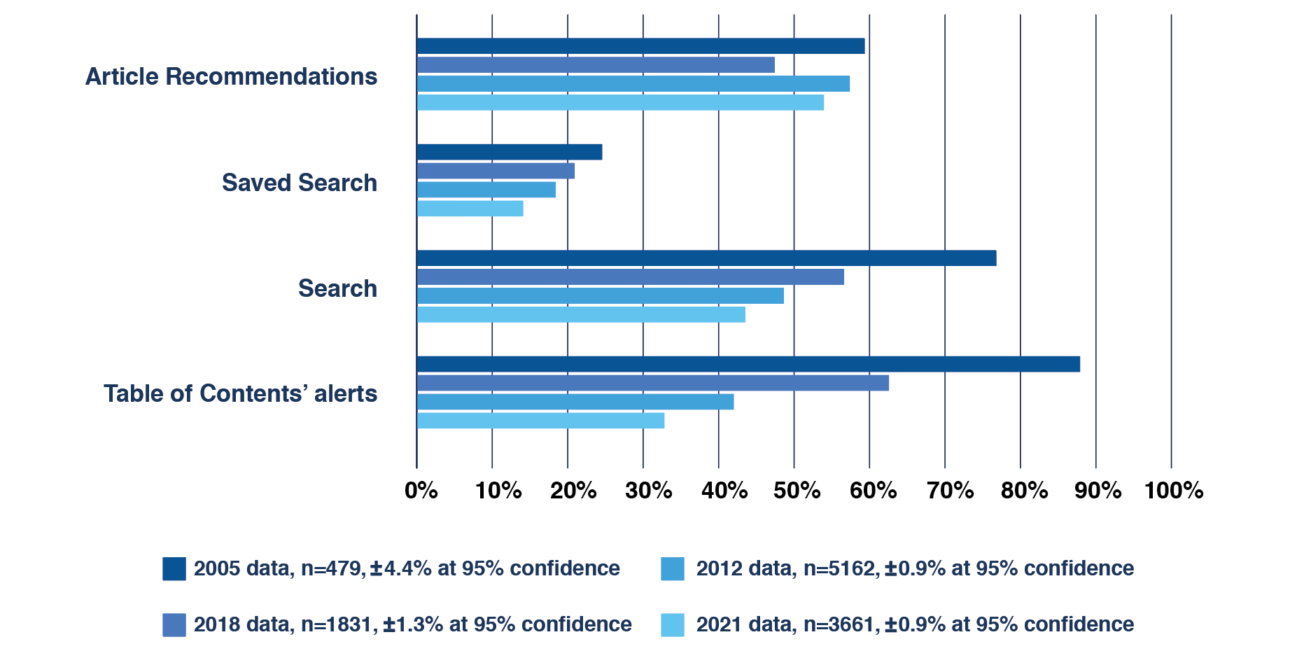
Browsing on publishers websites
“Related articles remain the most popular feature of a publisher website.” How Readers Discover Content in Scholarly Publications, Gardner & Inger, Jul 2021
https://renewconsultants.com/wp-content/uploads/2021/07/How-Readers-Discover-Content-2021.pdf

Slide 5
TrendMD is used on over 6,200 scholarly websites by 500+ publishers
Publishers
Integration partners

Slide 6
TrendMD audience reach
5M+
Monthly Clicks
102M+
Monthly Uniques Globally
60%
Desktop
40%
Mobile
85%
US academic reached
90%
US MDs reached

Slide 7
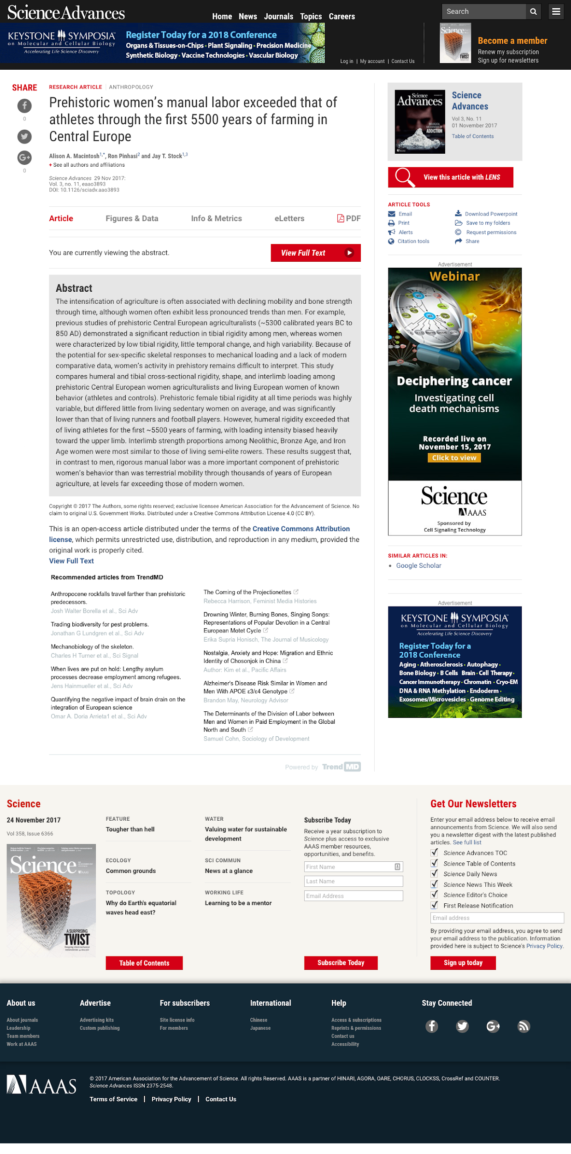
Readers discover new content, based on
What they are reading
What other users like them have read
What they have read in the past
1
2
3

Slide 8
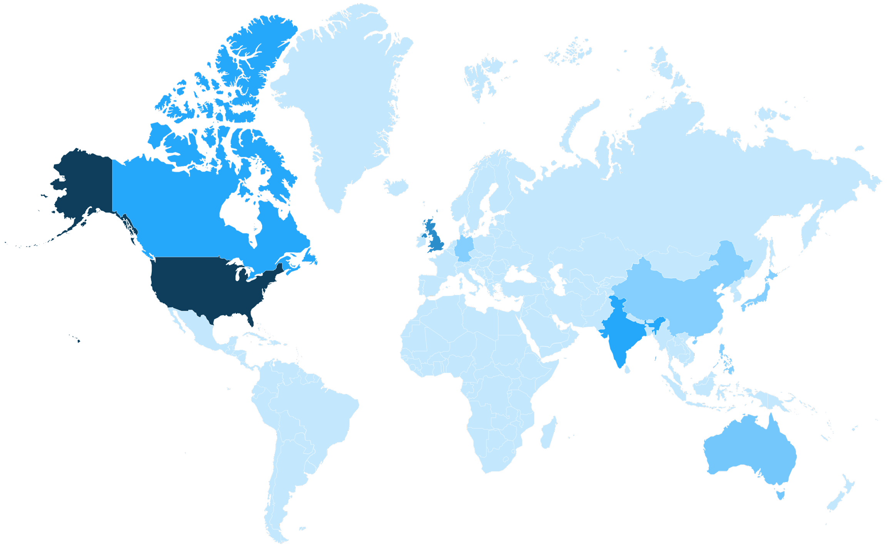
Global distribution
Country | Impressions | Global %
Total | 102.1M
United States | 49.0M | 48%
United Kingdom | 9.5M | 9.3%
India | 6.2M | 6.4%
Canada | 5.2M | 5.1%
Australia | 3.6M | 3.5%
Philippines | 1.6M | 1.6%
Germany | 1.4M | 1.4%
China | 1.2M | 1.2%
Japan | 1.1M | 1.1%
South Africa | 896K | 0.9%
France | 829K | 0.8%
Netherlands | 811K | 0.8%
Spain | 800K | 0.8%
Italy | 783K | 0.8%
Brazil | 714K | 0.7%
Singapore | 683K | 0.7%

Slide 9
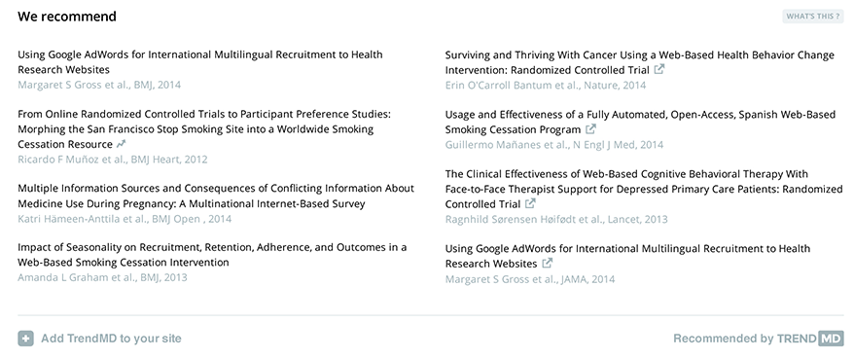
We provide recommendations within journals, blogs, other sites that academics, doctors, and researchers use in their day-to-day work
Article abstract
widget

Slide 10
Benefits: Publishers use TrendMD to maximize their growth
Grow your readership
Increase citations
Build brand awareness
Drive subscription revenue
Attract more authors
Drive conversions

Slide 11
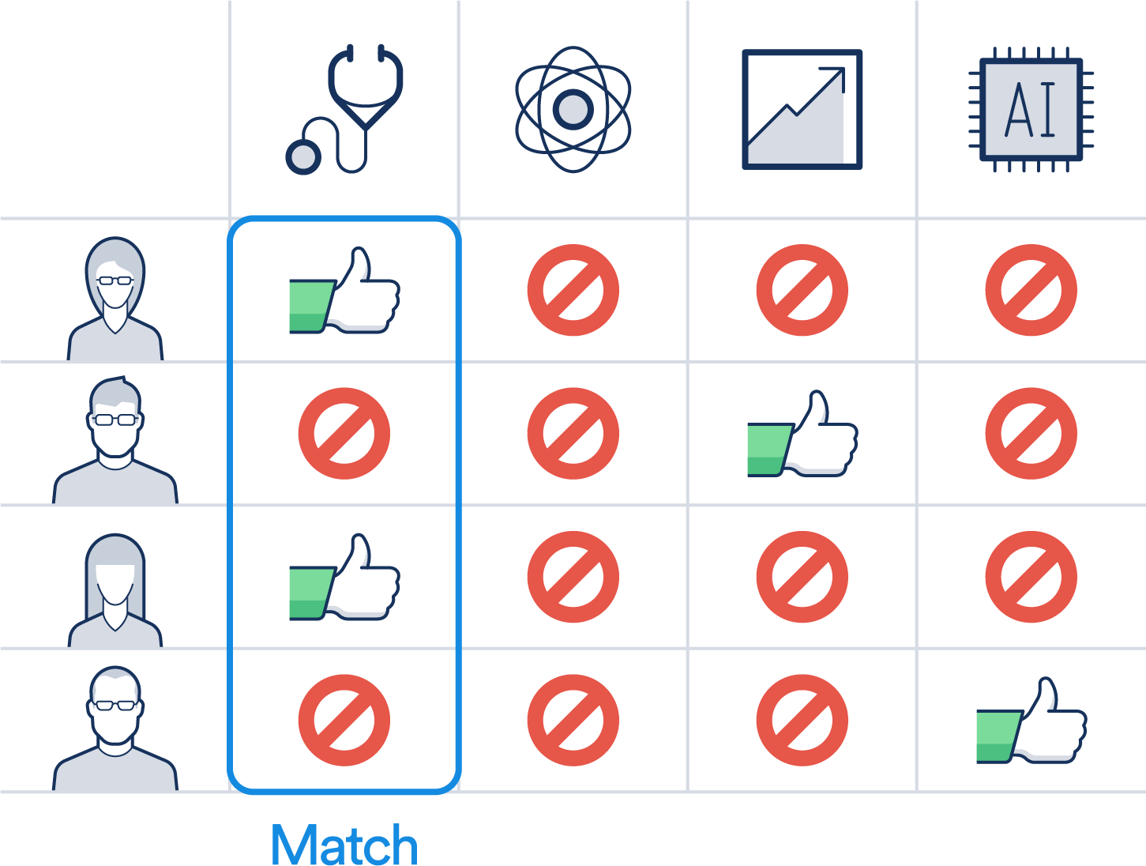
TrendMD generates recommendations via collaborative filtering i.e. ‘People who read this also read this’

Slide 12
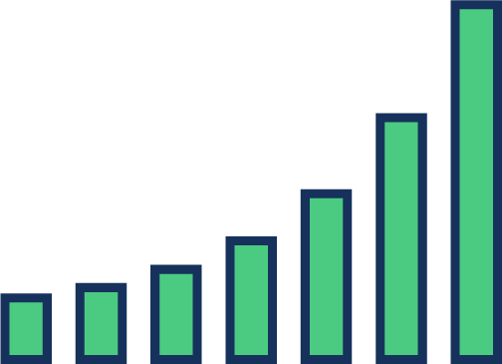
Understand more about your audience: analytics
How many additional readers did TrendMD refer?
Which articles are generating and receiving the most traffic?
What journals are my readers coming from?
In which third-party journals is your content trending?

Slide 13
Reader engagement
TrendMD readers view more articles per visit than readers from any other traffic source
0
1
2
3
4
Pages per session

Slide 14
With our campaigns you can choose targeting criteria important to you
Country or region (Global)
Institutional (Global) Target hospital networks, universities, colleges, organizations
User-targeting (Global) Target specific types of researchers and/or HCPs in the network, globally

Slide 15
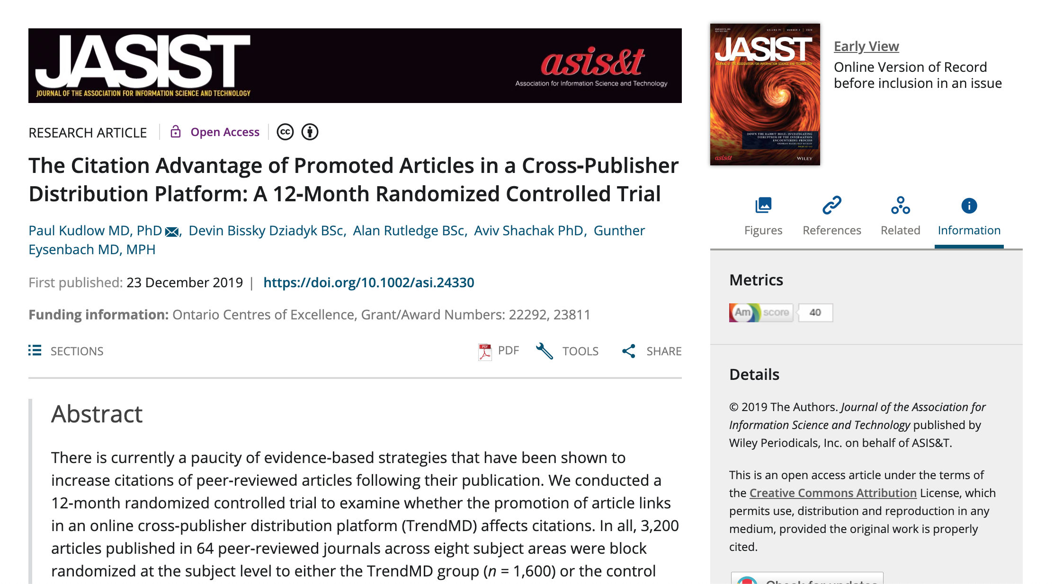
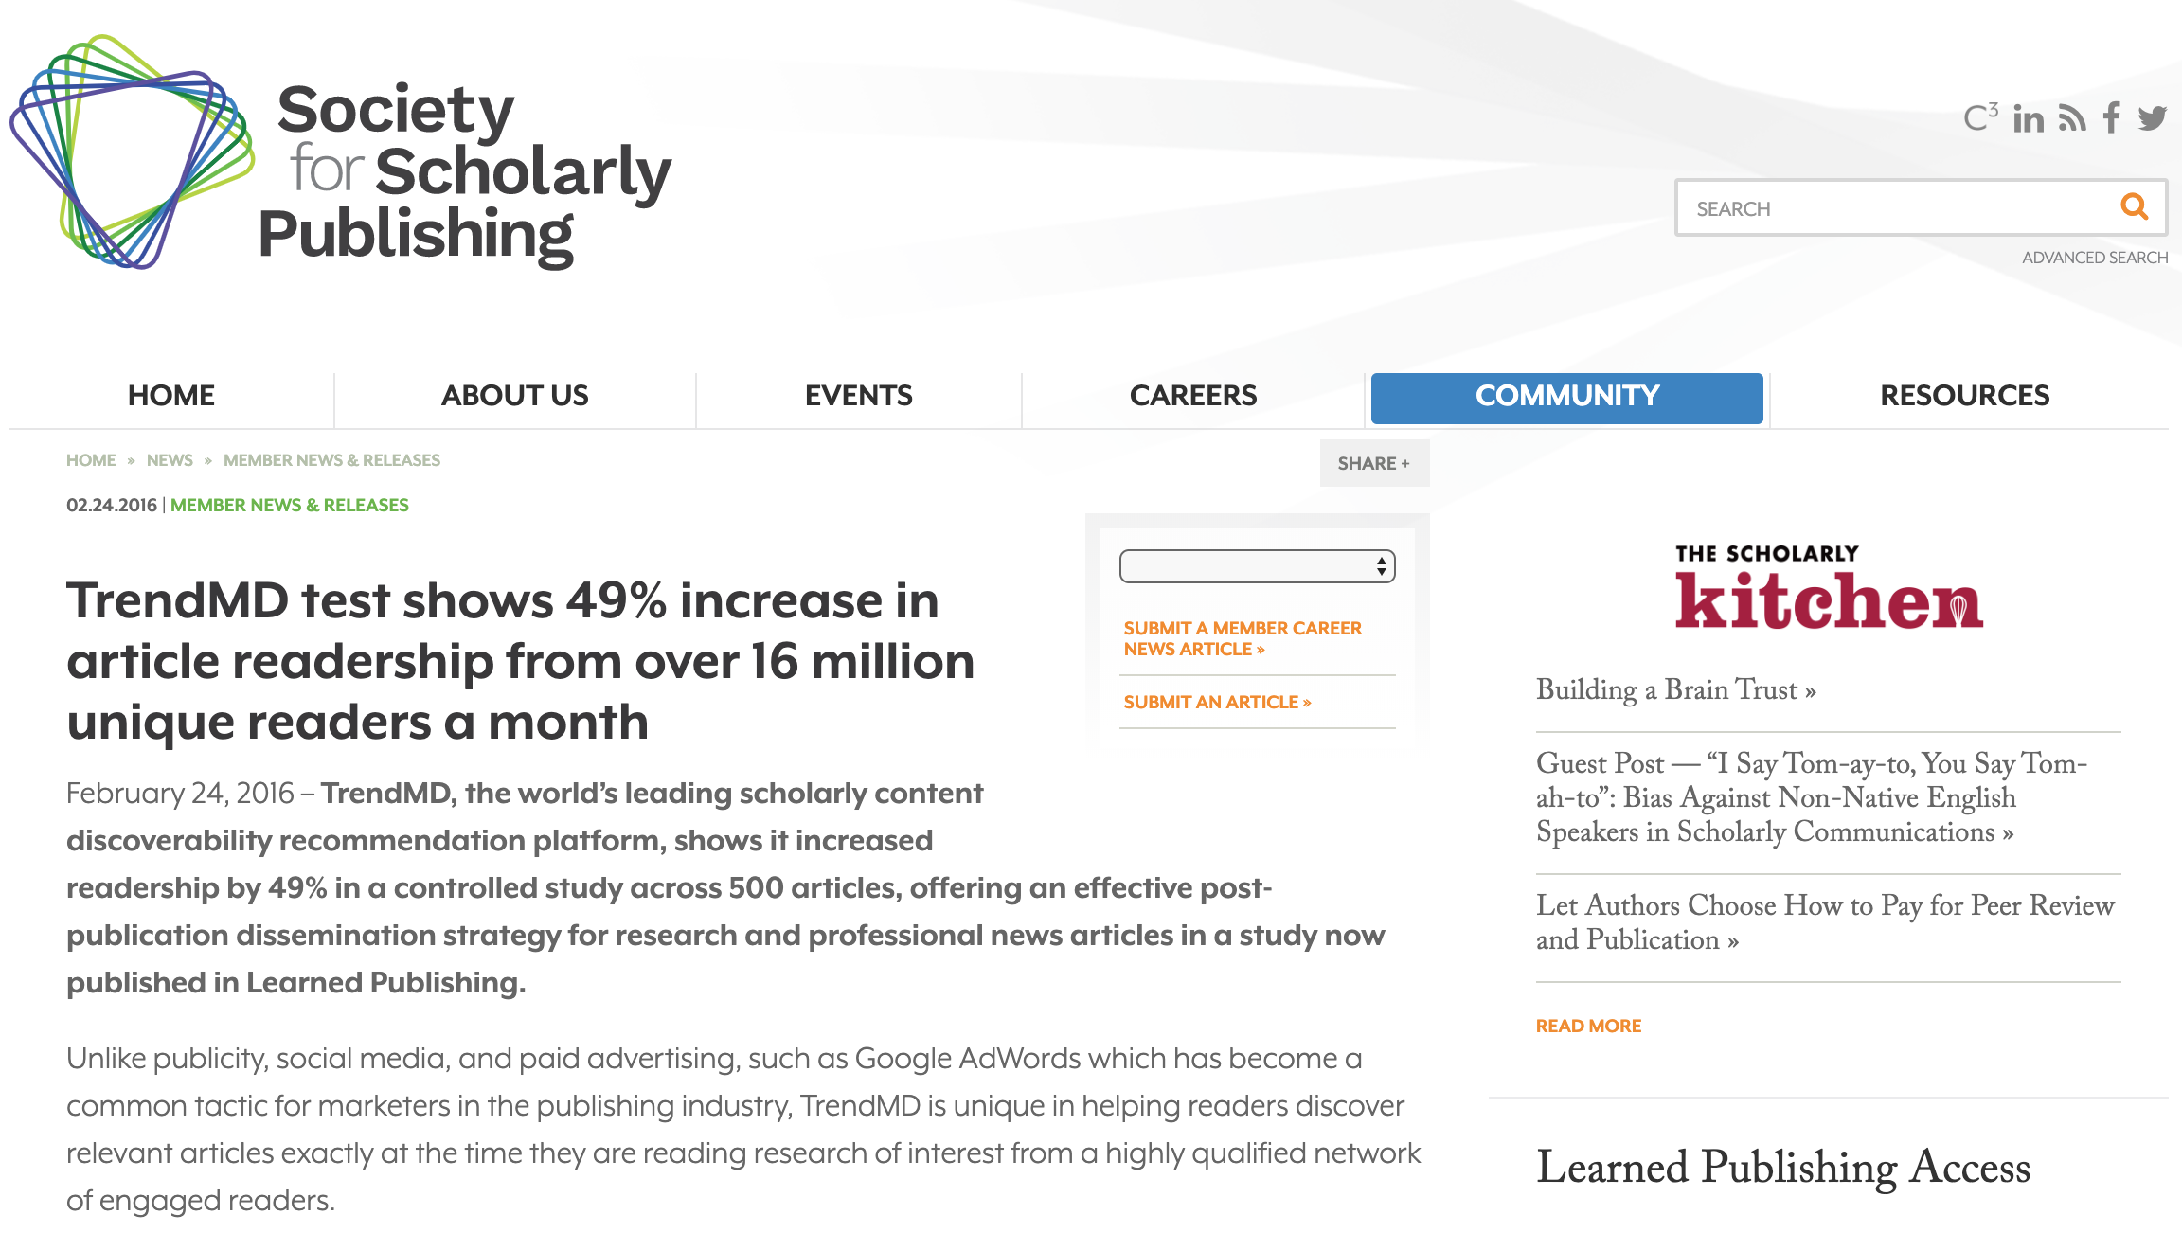
Case study #1: Increasing Citations and improving Impact Factor
12-Month Randomized Controlled Trial demonstrated that TrendMD-promoted articles received 50% more citations than the control group
‹#›
https://asistdl.onlinelibrary.wiley.com/doi/10.1002/asi.24330

Slide 16
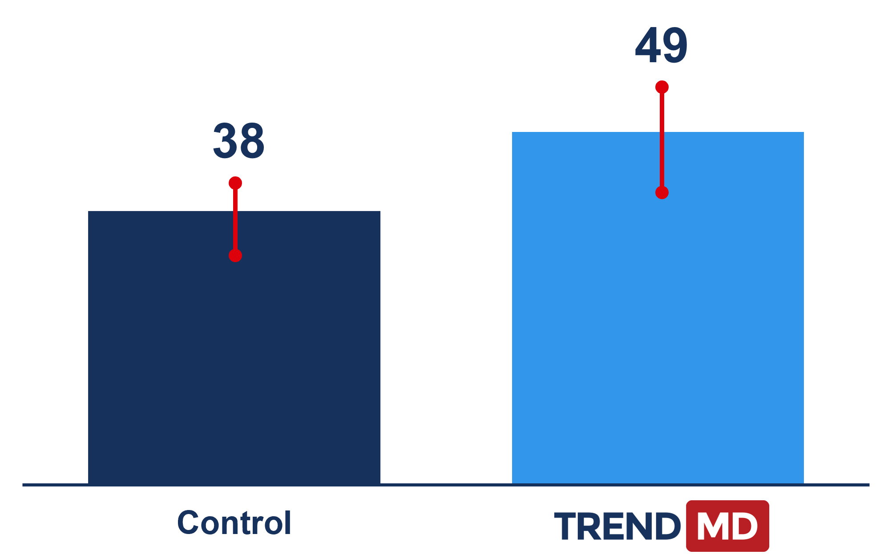
36-month follow-up to a randomized controlled trial
A follow-up study shows that the citation advantage of promoted articles in TrendMD persists at 36-months
TrendMD showed a 28% increase in mean citations relative to the control
‹#›
https://jmir.org/2021/12/e34051

Slide 17
Case study #2: Increasing Discoverability
Problem: Given the glut of information on Covid-19… How can the most valuable peer-reviewed content on the subject rise above the noise?
Publisher Experience: Covid- 19 Campaign
Number of articles promoted | 10
Number of days in campaign | 12
Total Budget | $1,500
Number of impressions | 5.6 million
Number of clicks | 1,600

Slide 18
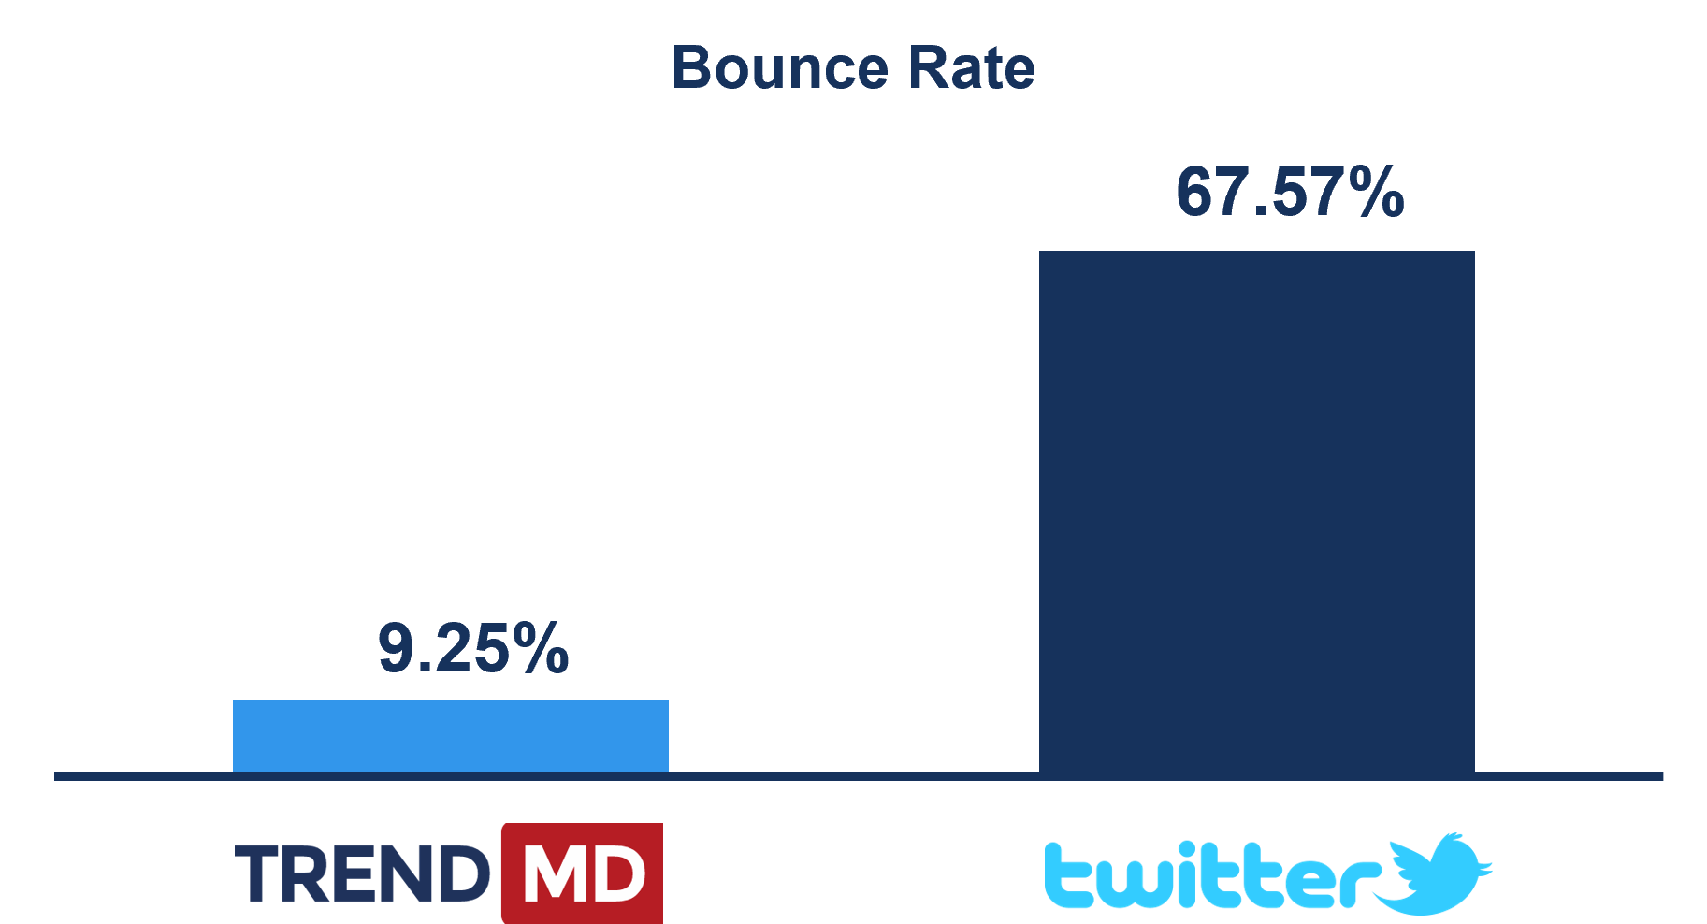
Case study #3: Springer uses TrendMD to increase readership of articles
SOURCE OF REFERRAL | AVG SESSION DURATION | PAGES /SESSIONS | % OF SESSIONS DOWNLOADED A PDF
Twitter | 00:01:14 | 1.65 | 4.94%
TrendMD | 00:02:52 | 1.84 | 7.53%
Notes:
Campaign Results for April-May (BMC GA account):

Slide 19
Thank you for listening!
For more info contact Charley MIAO
charley.miao@trendmd.com

